Slide 1

Project Innovation:
smart bus Optimizing Public Transport
IBM Naan Mudhalvan-Group 2
Internet Of Things(IOT)
Kingston engineering college
College code -5113
By
S. pavithra - naan mudalvan ID:au511321106019 , Email:pavithrasundervadivel04@gmail.com
R . Vijaya bharathi - naan mudalvan ID:au511321106026 , Email: Vijayabharathi152003@gmail.com
T. Madhu mitha - naan mudalvan ID: autle-06ece , Email: madhumithausha2002@gmail.com
S . vaideeswari - naan mudalvan ID: autle-01ece, Email: vaishusaravanan1315@gmail.com
S.Priya Dharshini - Naan mudalavan Id : autle-05ece, Email: priyadharshinis07092000@gmail.com

Slide 2

Project Definition
The project definition phase is crucial for outlining the goals, objectives, and scope of the optimization project. We will identify the current pain points in the public transport system, analyze user feedback, and gather data on passenger volumes and routes. This information will help us develop a comprehensive plan to enhance the overall travel experience. As the project innovation our goal is to optimize public transport by implementing various improvements. These include the replacement of conductors with seat allocation, bus time arrival notifications, reservation and a convenient payment system. By utilizing IoT sensors and a real-time transit information platform, we aim to create a seamless and efficient public transport experience. Let's explore the project document below to understand the steps involved in achieving this objective

Slide 3

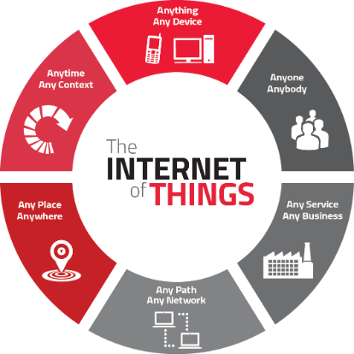


Design Thinking
Empathize
Define
Prototype
Gather insights and understand the needs and challenges of commuters.
Define the problem statement and establish project goals based on user research.
Create prototypes to visualize and test different concepts.

Slide 4

Project Objectives
1
Enhance Efficiency
2
Improve Passenger Experience
3
Increase Accessibility
Streamline bus operations and reduce delays through effective route planning and optimized schedules.
Offer real-time information, comfortable seating arrangements, and seamless connectivity.
Ensure accessibility for individuals with mobility challenges and provide user-friendly payment options.

Slide 5

IoT Sensor Design
Utilizing IoT sensors, we will create a smart monitoring system for buses. These sensors will collect data on passenger count, temperature, and location. This will enable us to optimize bus capacity, improve maintenance planning, and provide accurate arrival time predictions for passengers.

Slide 6

Real-Time Transit Information Platform
"Knowing when the next bus will arrive is a game-changer for commuters. Our real-time transit information platform will provide up-to-the-minute updates on bus arrival times, route changes, and any disruptions. Say goodbye to unpredictable waits and plan your journey with confidence."

Slide 7
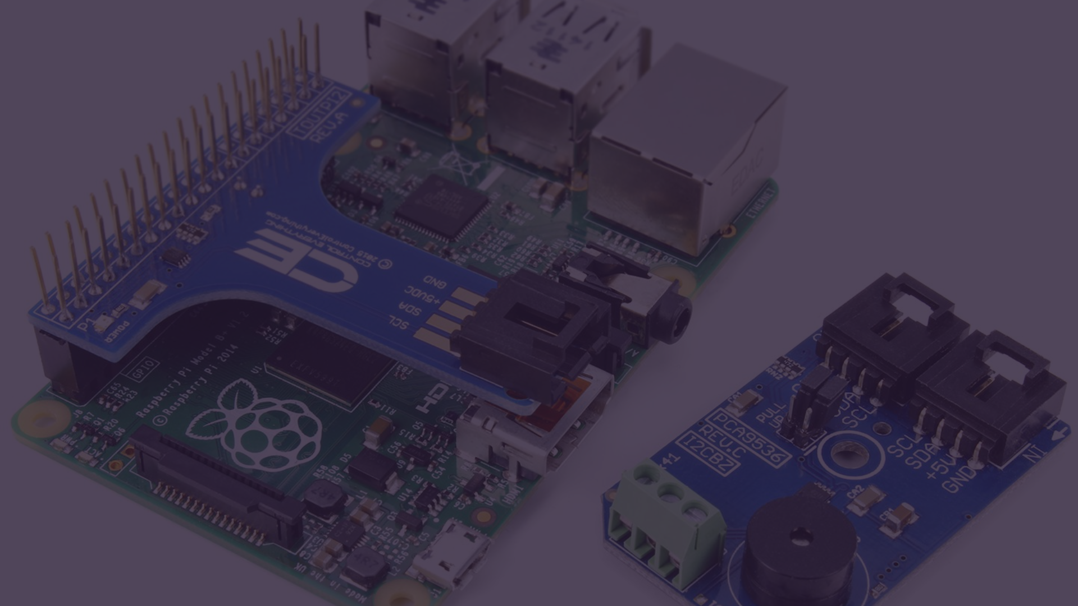
Integration Approach
IoT Sensors for Public Transportation
Data Connectivity
Establish secure and reliable data connections between buses, sensors, and the central information system.
GPS tracking sensors
Passenger counters
Temperature and humidity sensors
User Interface
Accelerometers for detecting sudden stops or impacts
Create an intuitive and user-friendly interface for passengers to access real-time information and manage bookings.
Proximity sensors for detecting nearby objects or people
Transportation cards will use IoT-based devices for contactless ticketing and payment, allowing for a safer and more convenient experience for passengers.
In addition to these sensors, we will use API integration to connect with existing transportation systems, such as fare collection and ticketing, to ensure a seamless user experience.

Slide 8
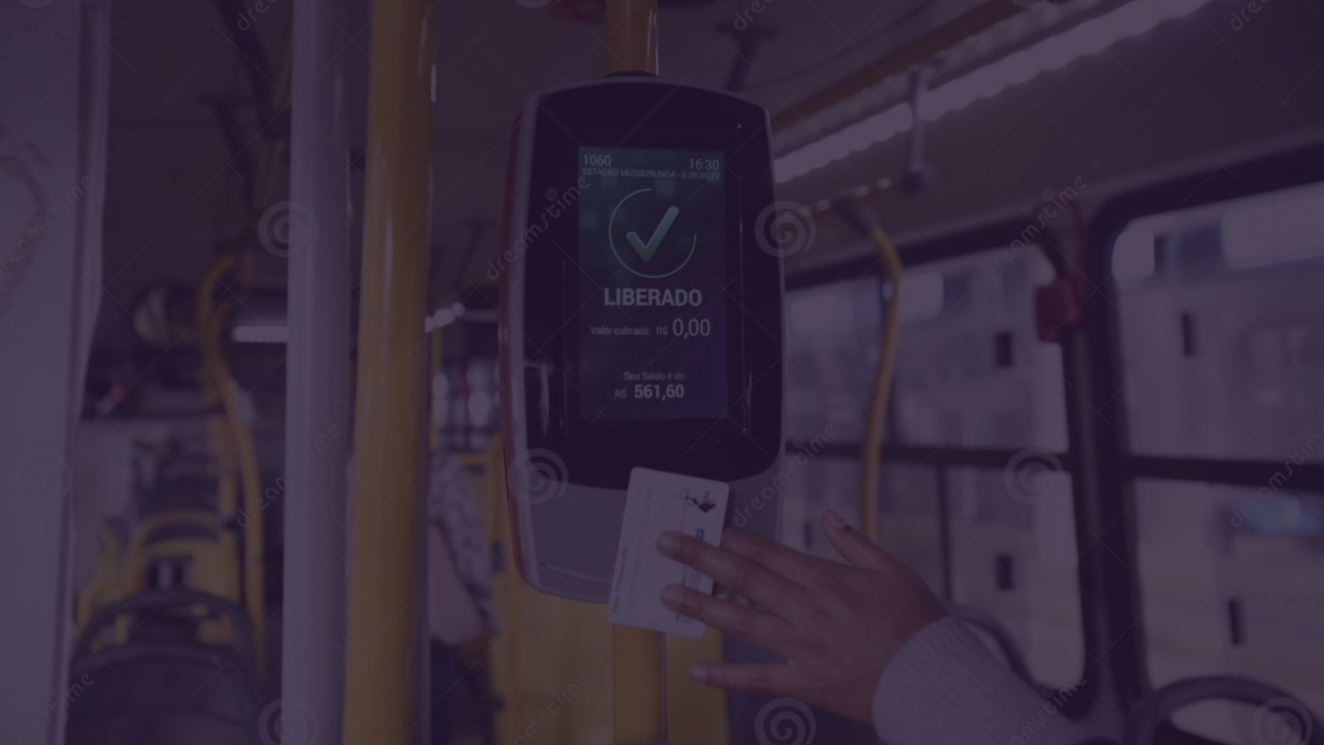
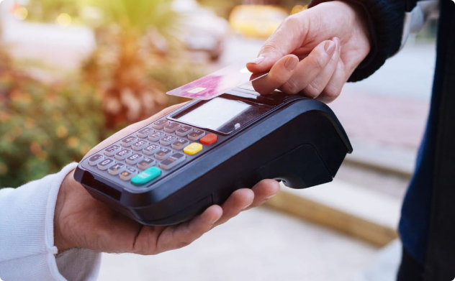
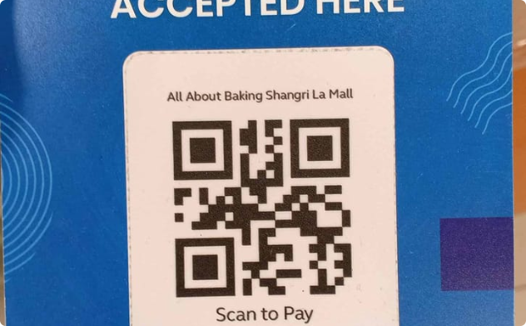
Payment System Improvement
Contactless Payment
QR Code Payment
Introduce contactless payment options using transportation payment cards or mobile devices for quick and convenient transactions.
Implement QR code payment solutions to facilitate easy and secure payments for passengers, including payments made with transportation payment cards.

